Slide 1
Section 1.4: Hamiltonian Circuits
Math for Liberal Studies

Slide 2
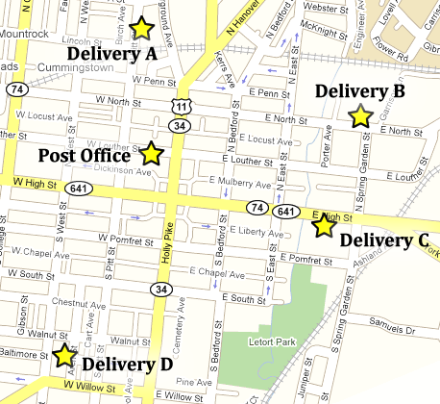
A New Kind of Problem
A postal worker needs to take several packages from the post office, deliver them to the four locations shown on the map, and then return to the office

Slide 3
A New Kind of Problem
The postal worker wants to know the best route to take to deliver the packages
Do we want to use Euler circuits to solve this problem?

Slide 4
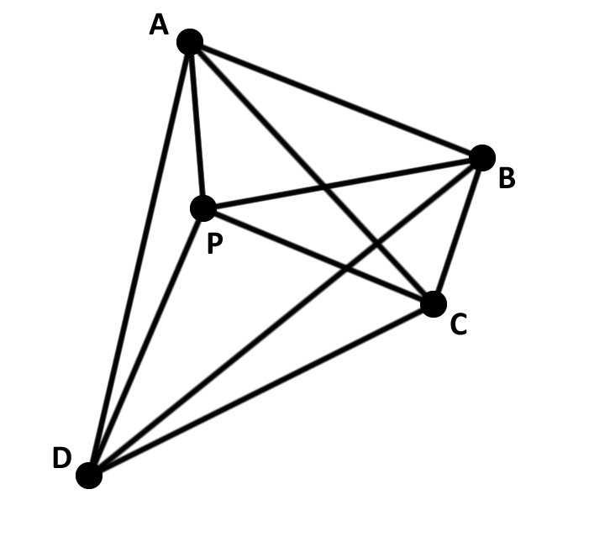
Modeling this Problem

Slide 5
A New Kind of Graph
This is called a complete graph because every pair of vertices is connected by an edge
This represents our ability to travel from any point to any other

Slide 6
A New Kind of Circuit
We don’t need an Euler circuit, which would have us travel along each edge
We just need to visit each vertex once and then return to our starting point

Slide 7
A New Kind of Circuit
A Hamiltonian circuit is a circuit that visits each vertex exactly once, except for the starting vertex, which is the same as the ending vertex

Slide 8
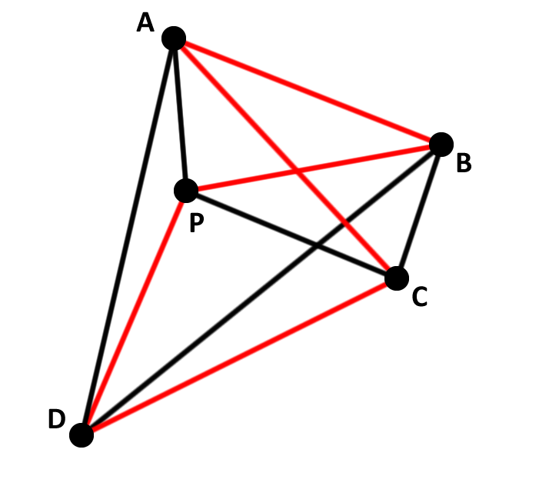
Examples of Hamiltonian Circuits

Slide 9
Finding the “Best” Circuit
We want to find the circuit that has the lowest total “cost”
Here “cost” might mean
travel time
distance
monetary cost
etc.

Slide 10
The Brute-Force Method
Examine all possible Hamiltonian circuits
Compute the total cost of all of these circuits
Choose the circuit with the lowest total cost

Slide 11
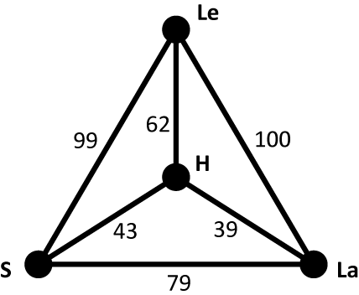
Example: Road Trip!
Suppose you want to take a road trip for Spring Break
You want to start from Shippensburg (S), and visit Harrisburg (H), Lancaster (La), and Lewisburg (Le) in some order before returning to Ship

Slide 12
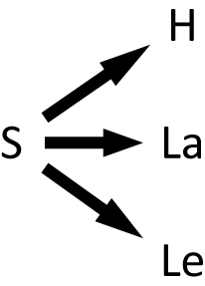
Step 1: Find All Possible Circuits
From Shippensburg, we have three choices for our first destination

Slide 13
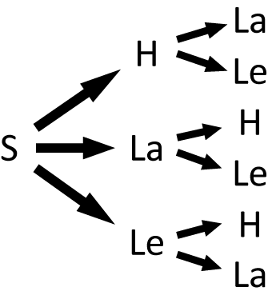
Step 1: Find All Possible Circuits
From each of these possibilities, we now have two choices

Slide 14
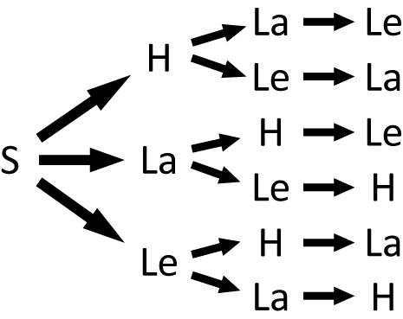
Step 1: Find All Possible Circuits
Next, we only have one choice remaining

Slide 15
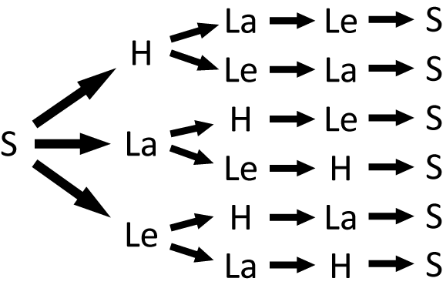
Step 1: Find All Possible Circuits
And finally, we must return to S

Slide 16
Step 2: Find the Cost of Each Circuit
Circuit | Cost
S – H – La – Le – S | 43 + 39 + 100 + 99 = 281
S – H – Le – La – S | 43 + 62 + 100 + 79 = 284
S – La – H – Le – S | 79 + 39 + 62 + 99 = 279
S – La – Le – H – S | 79 + 100 + 62 + 43 = 284
S – Le – H – La – S | 99 + 62 + 39 + 79 = 279
S – Le – La – H – S | 99 + 100 + 39 + 43 = 281

Slide 17
Step 3: Choose the Lowest Cost Circuit
Circuit | Cost
S – H – La – Le – S | 43 + 39 + 100 + 99 = 281
S – H – Le – La – S | 43 + 62 + 100 + 79 = 284
S – La – H – Le – S | 79 + 39 + 62 + 99 = 279
S – La – Le – H – S | 79 + 100 + 62 + 43 = 284
S – Le – H – La – S | 99 + 62 + 39 + 79 = 279
S – Le – La – H – S | 99 + 100 + 39 + 43 = 281

Slide 18
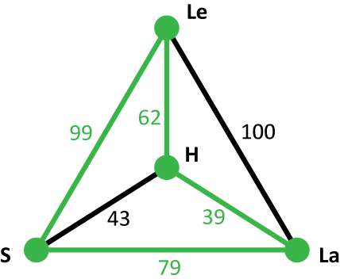
It’s a tie! Or is it?
If we draw these two circuits, we find that in fact they are the same
One circuit is the reverse of the other, so the total costs are the same
In fact, while it looked like there were 6 total circuits, really there were only 3

Slide 19
Pros and Cons
The brute force method is good because we know for sure we find the best possible answer
The biggest disadvantage of the brute force method is that the total number of circuits gets very large if we look at graphs with more vertices

Slide 20
How Many Circuits?
In our example, we had 4 total vertices
So from our starting point, we had 3 choices, then we had 2 choices, then 1 choices, then no choice but to go back to the start
That gave us 3 × 2 × 1 = 6 total circuits
But really there were only half that: 3 circuits

Slide 21
How Many Circuits?
What if we had 5 total vertices?
We would have 4 choices, then 3, then 2, then 1, then back to the start
That gives us 4 × 3 × 2 × 1 = 24 total circuits
And again there would only really be half that: 12 circuits

Slide 22
How Many Circuits?
The calculation we are doing is a common one in mathematics, called factorial
The factorial of a whole number n is the product of all the whole numbers between 1 and n
Factorial is written with an exclamation point: n! = n × (n – 1) × … × 3 × 2 × 1
For example: 5! = 5 × 4 × 3 × 2 × 1 = 120

Slide 23
How Many Circuits?
Factorial numbers grow very quickly
7! = 5040
This means that if we had tried to solve our road trip problem with 8 locations instead of 4, we would have had to consider over five thousand circuits instead of just six

Slide 24
Other Applications
Fishermen laying and collecting traps from certain locations (“Deadliest Catch”)
Vending machine company collecting money from various machines around campus
School bus picking up special-needs children from certain houses in a town
Programming a robot to spot-weld certain locations on a car frame

Slide 25
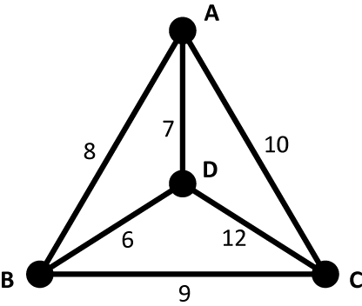
Your Turn
Use the brute-force method to find the lowest-cost Hamiltonian circuit for this graph
Examine all possible Hamiltonian circuits
Compute the total cost of all of these circuits
Choose the circuit with the lowest total cost

Slide 26
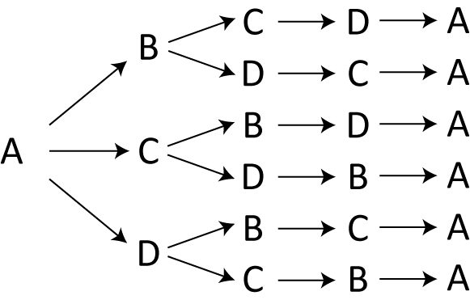
1. Examine all possible Hamiltonian circuits
First we make a “tree diagram” that lists all of the Hamiltonian circuits
Notice that we chose A as our starting point, but really we could have started anywhere

Slide 27
2. Compute the total cost of all of these circuits
Now we add up the total cost of each circuit
Notice that we get every circuit twice
Circuit | Cost
A – B – C – D – A | 8 + 9 + 12 + 7 = 36
A – B – D – C – A | 8 + 6 + 12 + 10 = 36
A – C – B – D – A | 10 + 9 + 6 + 7 = 32
A – C – D – B – A | 10 + 12 + 6 + 8 = 36
A – D – B – C – A | 7 + 6 + 9 + 10 = 32
A – D – C – B – A | 7 + 12 + 9 + 8 = 36

Slide 28
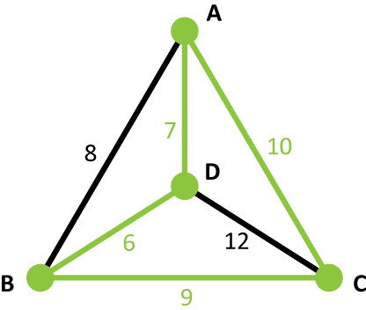
3. Choose the circuit with the lowest total cost
Finally, we choose the cheapest circuit
Circuit | Cost
A – B – C – D – A | 8 + 9 + 12 + 7 = 36
A – B – D – C – A | 8 + 6 + 12 + 10 = 36
A – C – B – D – A | 10 + 9 + 6 + 7 = 32
A – C – D – B – A | 10 + 12 + 6 + 8 = 36
A – D – B – C – A | 7 + 6 + 9 + 10 = 32
A – D – C – B – A | 7 + 12 + 9 + 8 = 36

